Slide 1
Attributes: Extraction and integration with Knowledge Bases
Sunita Sarawagi
IIT Bombay
ACM summer school on NLP and Machine Learning, June 2017

Slide 2
Web Search today
Web search has evolved since the days when the answers to all queries were ten blue links
Information Retrieval problem
Now: many queries get an exact answer almost as if you asked a clean structured database
Queries classified as per the type of structured information they seek: entity query, entity-attribute queries, list queries
Each type: own processing pipeline and presentation

Slide 3
Entity Query
Who is the president of United States?

Slide 4
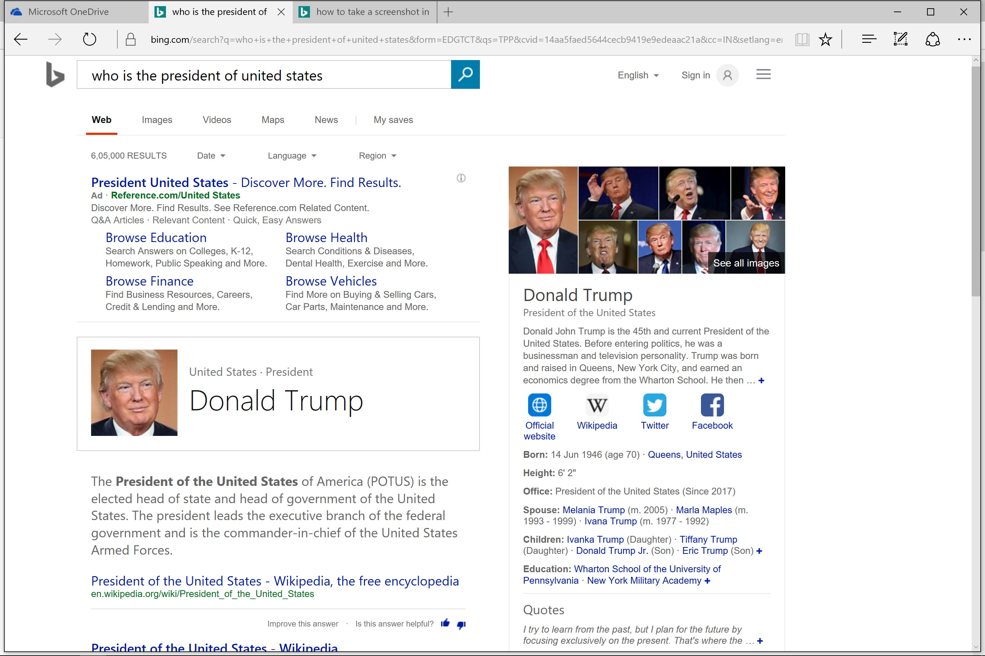

Slide 5
Entity Attribute Query
Donald Trump Net Worth

Slide 6
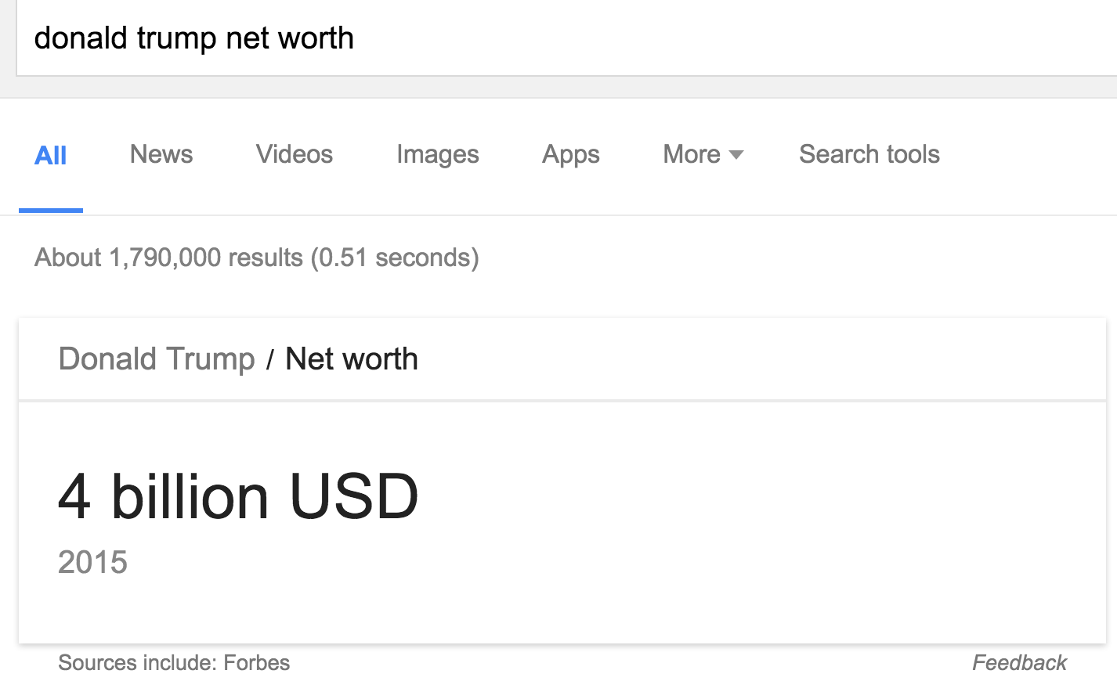

Slide 7
List Query
US Presidential candidates 2016

Slide 8
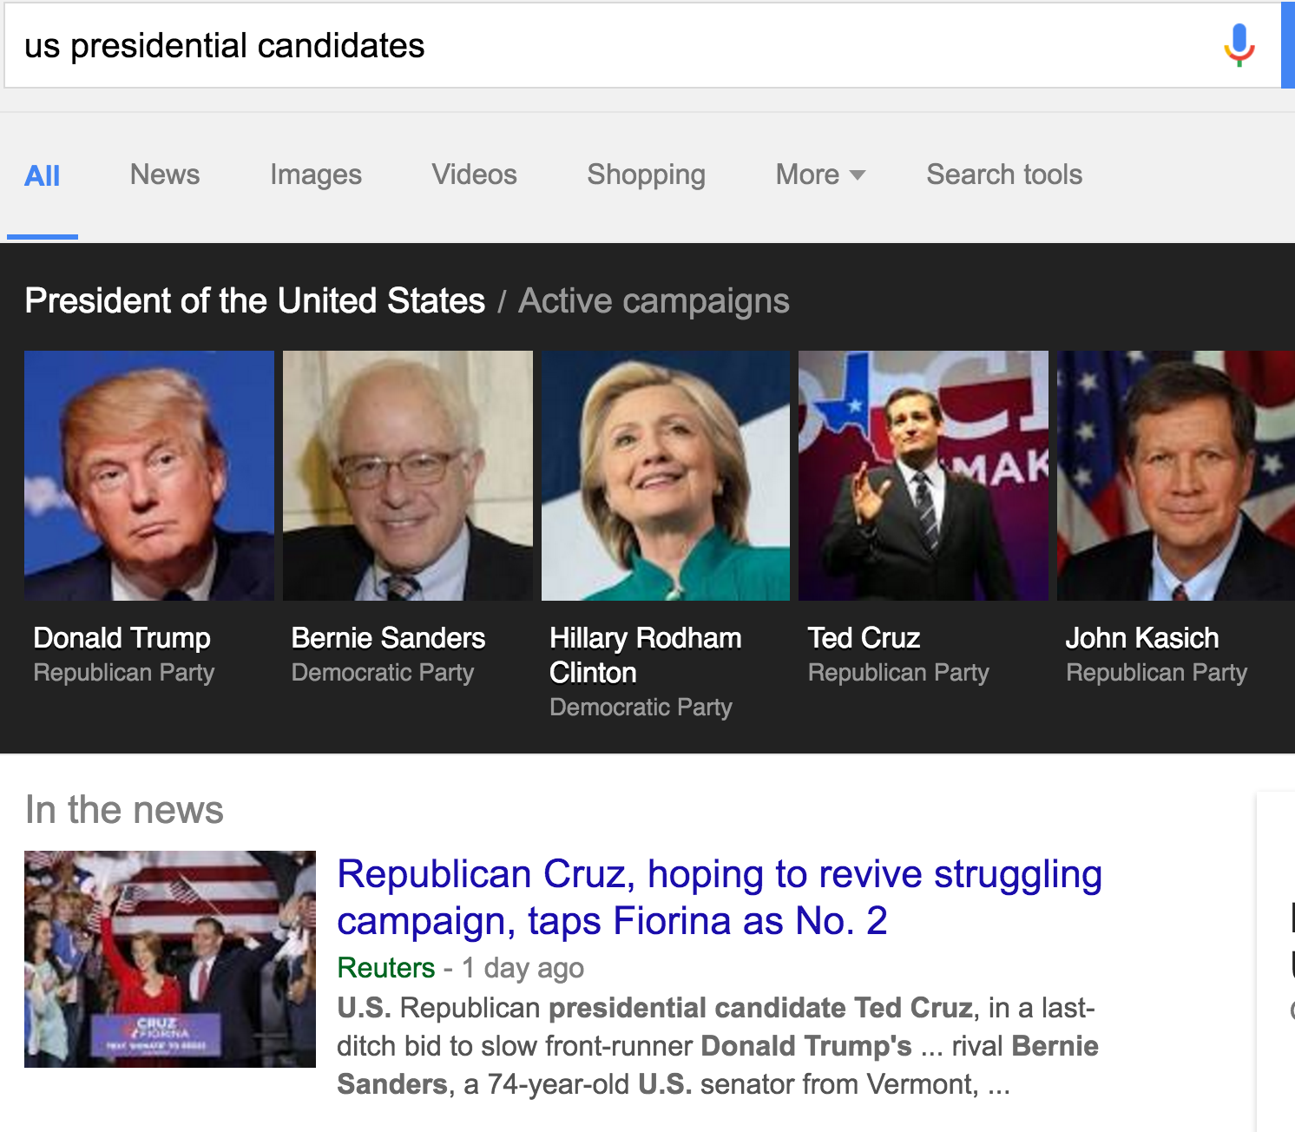

Slide 9
Web Search today
Web search has evolved since the days when the answers to all queries was ten blue links
Information Retrieval (IR) problem
Now: many queries get an exact answer almost as if you were asking a clean structured database
Entity query: “Donald Trump”
Entity Attribute query: “Donald Trump Net Worth”
List queries: “US presidential candidates 2016”
Less of an IR problem...More of a DB problem
Notes:
Let us elaborate on this claim by looking at a particularly databasy query type: the entity-attribute query

Slide 10
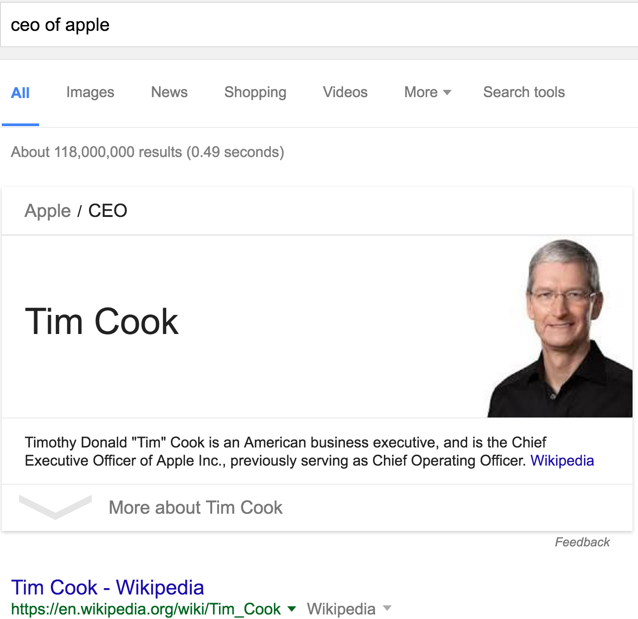
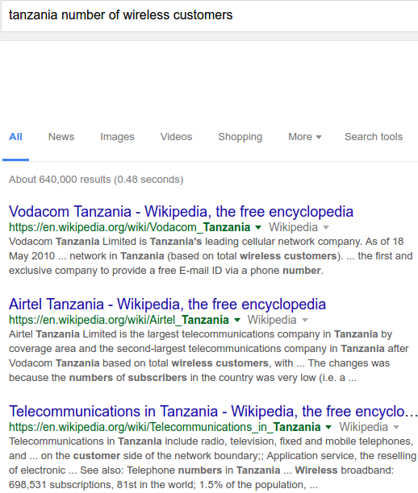
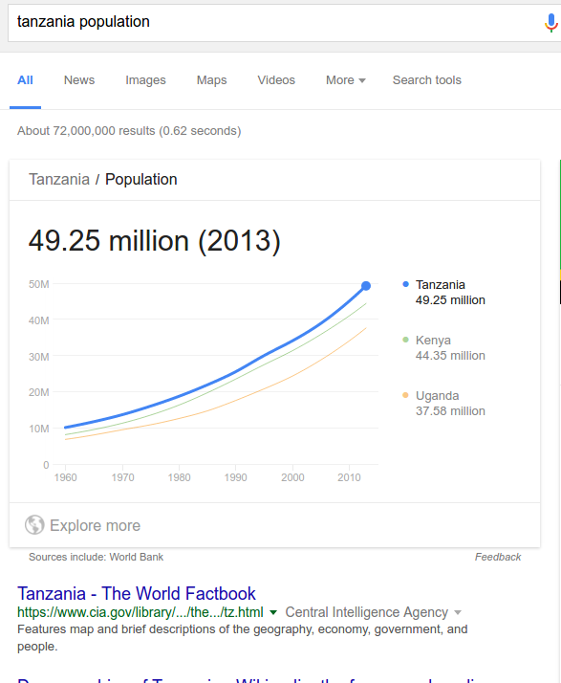
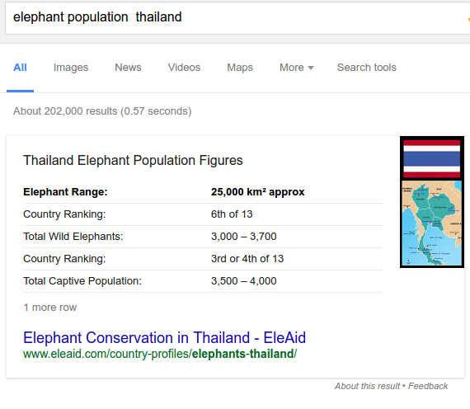
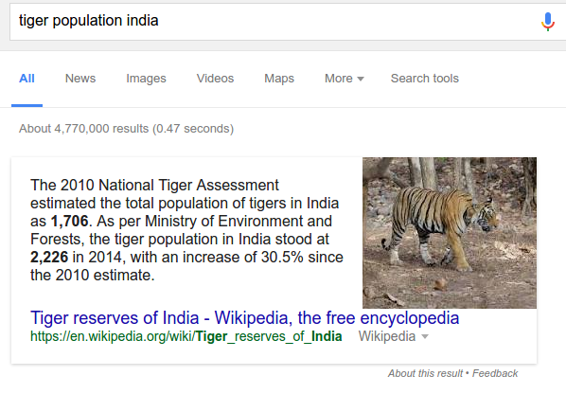
Entity-Attribute queries in Web Search
Attributes of entities: a large fraction of Web search queries
Search engines succeed at various levels...
Notes:
A large fraction of search queries on the web ask for values of attributes of entities. Search engines seek to return to the answer the “precise value” as answer rather than refer you to 10 blue links. They succeed at different levels.
Exact answer for some queries
A relevant text paragraph with highlighted answer

Slide 11
Components of an entity-attribute answer engine
Knowledge Base
Factual knowledge
Human curated
High-quality
Huge
Population
Schema
Number
Country
Capital
Cities
Revenue
Number
Company
CEO
People
Type
Population
49 M
Tanzania
Attribute names
IsA
Data
Class
Capital
Dodoma
Country
Entities
Company
Revenue
1.1 B
Entities
IsA
Apple
CEO
Tim cook
Notes:
Given the huge diversity and scale of anything on the Web, even a simply-stated entity-attribute query can be extremely hard to answer exactly.
Search engines spend enormous resources and need to get many details right to distil the exact answer given the bewildering variety of user queries over the chaotic ocean of information that is the Web.
In recent years, one big savior has been this huge yet manually curated repository of structured information called the knowledge base.

Slide 12
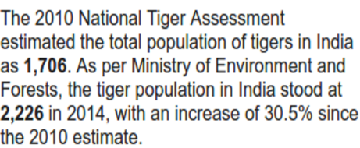
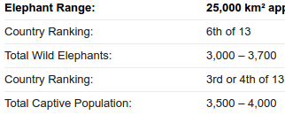
Components of an entity-attribute answer engine
Knowledge Base
User Query Q
Population
Navigational
Schema
Number
Query type?
List seeking
Country
Capital
Cities
Entity-attribute
query
Entity
Revenue
Number
Company
CEO
Parse Q: Find (E, A)
People
Population
49 M
Yes: Head query
Tanzania
Answer in KB?
Done
IsA
Data
Capital
Dodoma
No: Tail query
Country
Extract from Web
Text / Tables / Lists
Company
Revenue
1.1 B
IsA
Apple
CEO
Tim cook
Notes:
KB stores factual information about the world. A typical KB contains billions of entities like
Entities == blue.
Classes == Green
Attribute names == yellow
Attributes can be numeric or come from a fixed domain.
Top-part we have the schema that indicates what entity class can have what attribute and what is their domain.
Bottom part is the data itself that can be thought of as triples.
Answer in KB: mostly works for head queries, manually created, cannot target the long-tail universe.
Answering/highlighting an exact answer from an arbitrary text or table on the web is not easy. Much work has been done on this topic. Many details have to be right as we will see later.
For tail queries: extract from Web text and Web-tables
Well-interpreted query can be better matched to table titles/column headers.

Slide 13
Answering entity-attribute queries
Recognize and interpret entity and attributes in query
Tanzania population
Key input: Knowledge Base
Tanzania wireless customer base
Population
No such attribute in KB
49 Million
Tanzania
IsA
Capital
Country
IsA
Population
1.1 Billion
India
Capital
Notes:
Let us look a bit under the hood to try and understand why the first two queries succeeded and the third one failed.
The first step is to Among other signals: one key input is the KB.

Slide 14
Long tail of attributes not in KB schema
Users ask for many more attributes: About 100,000 for countries:
Soybean production
Wireless customer base
Tiger population
Drinking age
Knowledge Base
User Query Q
Population
Navigational
Very few distinct attributes of classes About 100 for countries
Query type?
Schema
Number
List seeking
Country
Capital
Cities
Entity-attribute
query
Entity
Revenue
Number
Company
CEO
Parse Q: Find (E, A)
People
Population
49 M
Yes
Billions of entities and fact triples about entities
Tanzania
Answer in KB?
IsA
Data
Done
Capital
Dodoma
No
Country
Extract from Web
Text / Tables / Lists
Company
Revenue
1.1 B
IsA
Apple
CEO
Tim cook
Notes:
This talk is about a few ideas that I and my colleagues have explored over the past few years in increasing the number of entity-attribute queries particularly in the long tail for which we get exact answer.
The first road-block to answering entity-attribute queries comes in the early parsing stage when we attempt to use a KB to recognize queries as E-A queries.

Slide 15

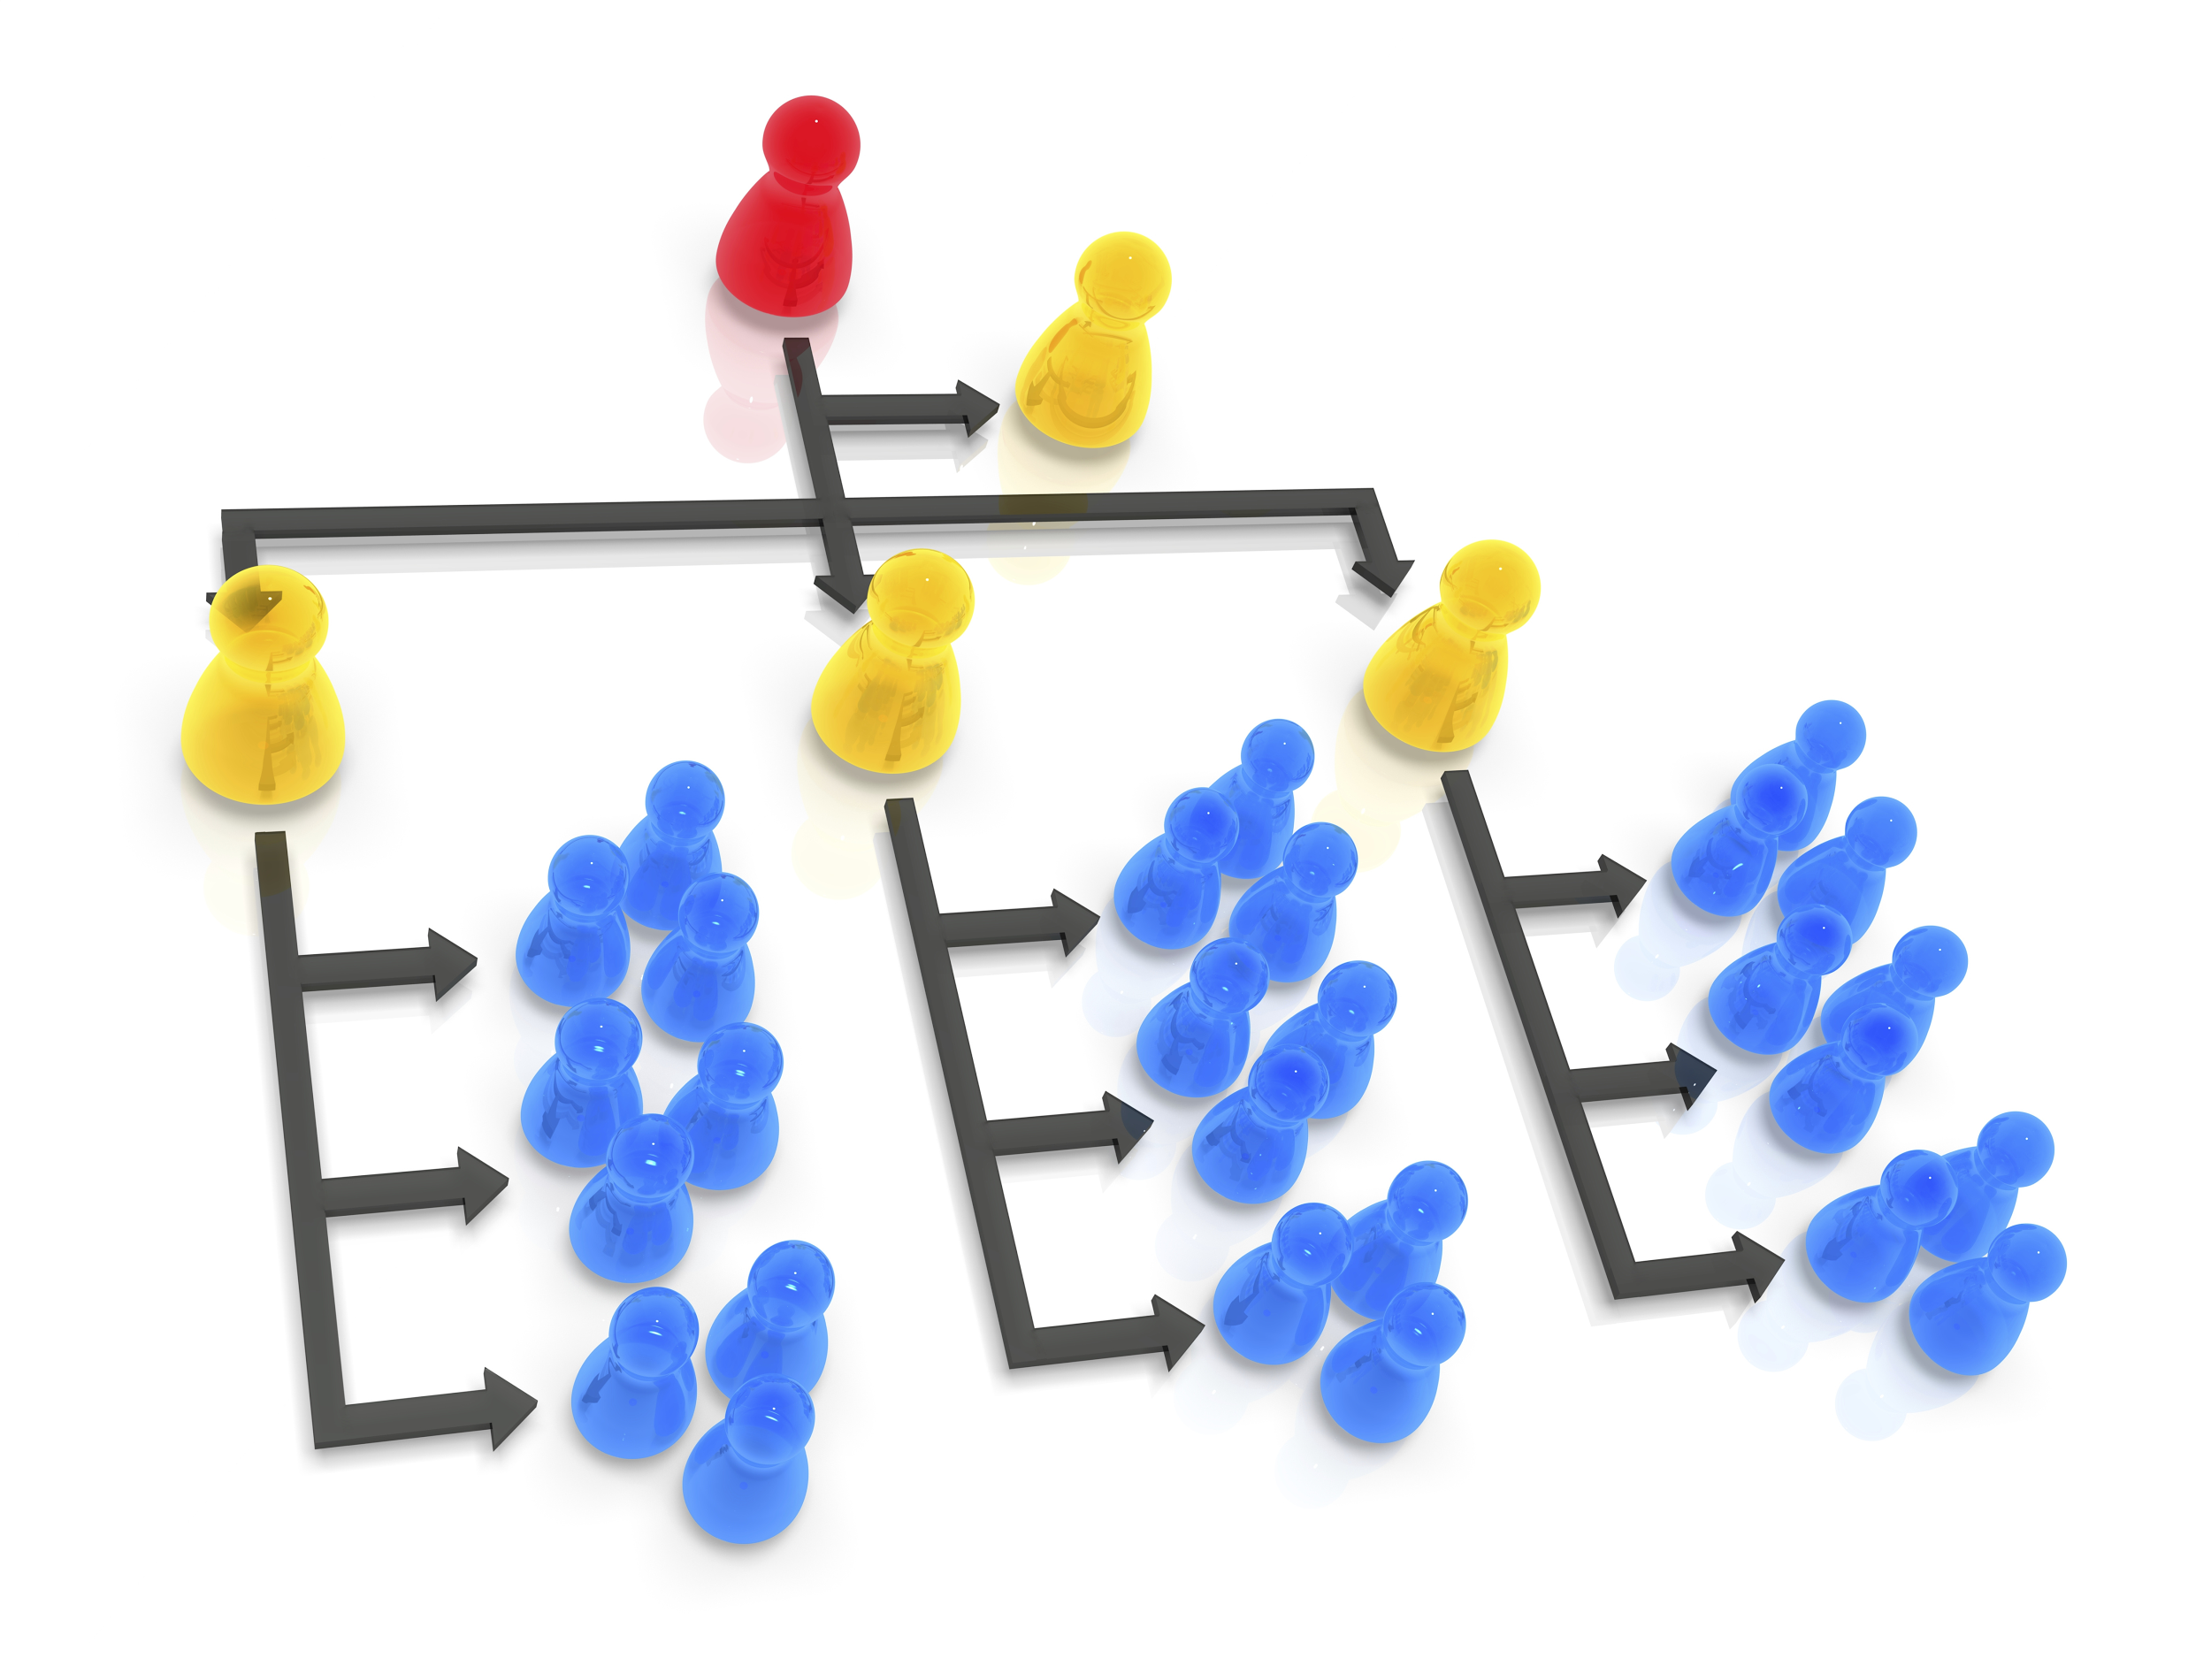

In this talk
Extract attributes
From Web-text and Query-logs
Organize extracted attributes
Remove noise to meet precision needs of KBs
Generalize to induce even more attributes
Execute entity-attribute queries
Long-tail: value not in KB
Attribute type is number
Seek answer in tables on the Web
Notes:
Go faster. Don’t go over sub-bullets
Start this talk by reviewing a system Biperpedia developed by Google colleagues for automatically extracting long-tail attributes from query-logs.
But before these can be used to populate a KB, need to remove inevitable noise by efficient curation. Our approach is to develop a grammar: that is human-interpretable and has other incidental advantages like induction of more attributes not in logs and handle compositonal queries.

Slide 16
Extracting Attribute Names as in Biperpedia
Extracts attributes of entity-classes from
Query-logs O(billions)
Captures what is of interest to users
Clean text like Wikipedia
Captures encyclopedic attributes
Biperpedia: An ontology for search applications in VLDB 2014.

Slide 17
Attributes harvested from Biperpedia
Countries
People
Sports Cars
...
history
biography
price
economy
age
specs
religions
height
engine
capital
birthday
model
~100K
~10K
~2K
...
...
...
corporate tax rate
family tree
color codes
population density map
meaning of name
fuel tank capacity
...
...
...
25 million class-attribute pairs (Vs 52K in DBpedia)
Two orders of magnitude more attributes than in Freebase!

Slide 18
Extracting Attributes from query logs in Biperpedia
Collect valid attribute names
From “What is <A> of <E>” queries
What is the tiger population of India?
What is the soybean production of Canada?
Attributes
Notes:
Transition from 1 to 2.
Challenge: entity-attribute queries mixed in with 10X other irrelevant queries. Bootstrap with strong seed patterns.
Absolute number of such queries large enough for high recall when you look at billions of queries.

Slide 19
Extracting Long Tail Attributes in Biperpedia
Collect valid attribute names
From “What is <A> of <E>” queries
What is the tiger population of India?
What is the soybean production of Canada?
Collect Entity, Attribute pairs
From <A> <E> or <E> <A> queries
Fire chief Palo Alto, Tanzania soyabean production
Attributes
Entity, Attribute Pairs
Attributes
Entities from KB
Notes:
Challenge: entity-attribute queries mixed in with 10X other irrelevant queries. Bootstrap with strong seed patterns.
Absolute number of such queries large enough for high recall when you look at billions of queries.
==
Biperpedia attaches attributes to classes of entities. Not done yet.

Slide 20
Extracting Long Tail Attributes in Biperpedia
Collect valid attribute names
From “What is <A> of <E>” queries
What is the tiger population of India?
What is the soybean production of Canada?
Collect Entity, Attribute pairs
From <A> <E> or <E> <A> queries
Fire chief Palo Alto, Tanzania soyabean production
Attributes
Entity, Attribute Pairs
Attributes
Entities from KB
Notes:
Challenge: entity-attribute queries mixed in with 10X other irrelevant queries. Bootstrap with strong seed patterns.
Absolute number of such queries large enough for high recall when you look at billions of queries.
==
Biperpedia attaches attributes to classes of entities. Not done yet.

Slide 21
Extracting Long Tail Attributes in Biperpedia
Collect valid attribute names
From “What is <A> of <E>” queries
What is the tiger population of India?
What is the soybean production of Canada?
Collect Entity, Attribute pairs
From <A> <E> or <E> <A> queries
Fire chief Palo Alto, Tanzania soyabean production
3. Generalize entities to their class in KB, group-by
Attributes
Entity, Attribute Pairs
Class, Attribute, Score
Notes:
Challenge: entity-attribute queries mixed in with 10X other irrelevant queries. Bootstrap with strong seed patterns.
Absolute number of such queries large enough for high recall when you look at billions of queries.
==
Biperpedia attaches attributes to classes of entities. Not done yet.

Slide 22
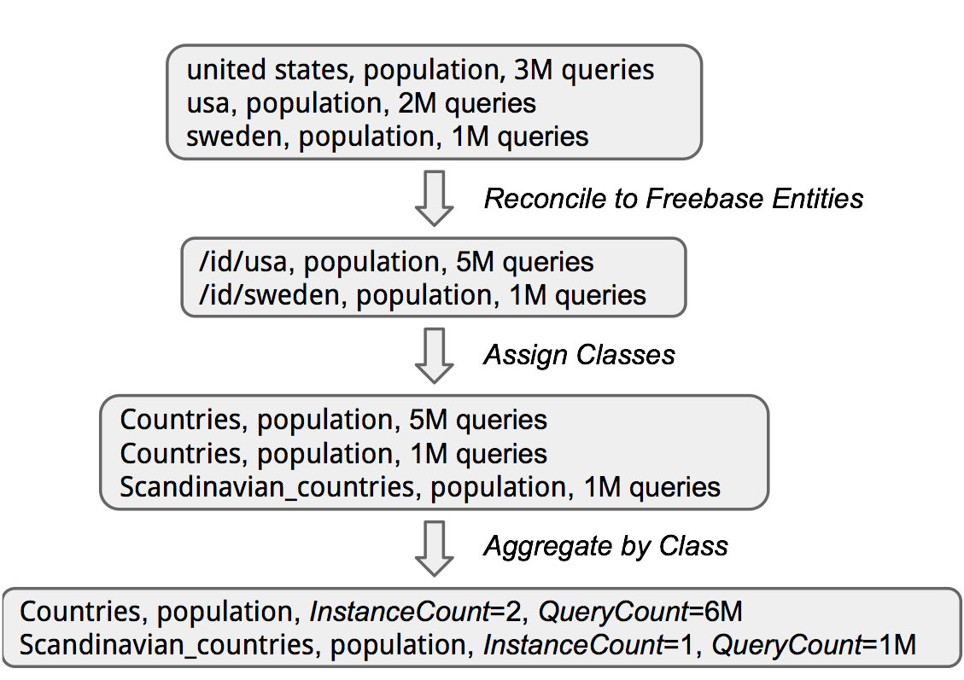
Aggregation per class

Slide 23
Extraction from Web Text
Consider the top attributes from queries
Learn text patterns expressing them:
“the gdp of X rose by Z”
Find similar sentences but with different attributes:
“the coffee production of X rose by Z”
Aggregate by class

Slide 24
Attributes harvested from Biperpedia
Countries
People
Sports Cars
...
history
biography
price
economy
age
specs
religions
height
engine
capital
birthday
model
Lessons learnt
Bootstrap from strong albeit rare pattern
Join noisy query-logs with high-quality entities in KB
Exploit redundacy:
Group entities to classes
Gather consensus from distinct entities
~100K
~10K
~2K
...
...
...
corporate tax rate
family tree
color codes
population density map
meaning of name
fuel tank capacity
...
...
...

Slide 25
Deploying the harvest..
Augmenting Knowledge bases
Missed precision target
KBs require 99.9% precision, Biperpedia gives 53%
Reranking on quality indicators misses recall
0.91 precision at 100, but 0.53 precision at 5000
Many good attributes at bottom rank!
Countries: aerospace experts, antitrust chief, deer population
Parsing queries → brittle
Attributes are atomic strings
“Deer population” present, “Armadillo population” absent
“Wheat production” present, “Mango production” absent.
⇒ Can we generalize?

Slide 26

In this talk
Extract attributes [Biperpedia]
From Web-text and Query-logs
Organize extracted attributes
Remove noise to meet precision needs of KBs
Generalize to induce even more attributes
Execute entity-attribute queries
Long-tail: value not in KB
Attribute type is number
Seek answer in tables on the Web
Notes:
Our approach is to do even more joins and aggregations and involve humans intelligently. This time it takes the form of a grammar: that is human-interpretable that implies efficient curation and has other incidental advantages like induction of more attributes not in logs.

Slide 27
Grammar over Attribute Names
Countries
Head Word
Concept node in a IsA hierarchy
$Ethnicity population
$Attribute
population
Notes:
Difference with clustering.
Improve recall. Consistent search user experience.
In practice will need checks and filters during parsing to prevent over-generalization much like in any grammar-based parsers.

Slide 28
IsA Concept Hierarchy
Hierarchy of concepts
Implicit in existing ontologies
Freebase, Wordnet
Finer-grained auto-generated from text patterns
More comprehensive
More noisy
thing
commodity
crop
drink
ethnicity
coffee
chinese
oil
gold
Notes:
Grammar generation?
The input to our grammar generating algorithm is the long list of attributes extracted by Biperpedia for any one class. Note this list is noisy. A second input is a large hierarchy of concepts. Many such resources available: example IsA nodes in freebase, wordnet. We want this to be as detailed and comprehensive as possible. So, it might be automatically extracted and could therefore be noisy as well.

Slide 29
Grammar over Attribute Names
Countries
Head Word
Concept node in a IsA hierarchy
chinese population
$Ethnicity population
indian population
$Attribute
Jewish population
Population in $Year
$Attribute in $Year
Population in 1991
Population in 2016
Chinese Population in 1991
Jewish Population in 2016
Notes:
Difference with clustering.
Improve recall. Consistent search user experience.
In practice will need checks and filters during parsing to prevent over-generalization much like in any grammar-based parsers.

Slide 30

Grammar groups semantically related attributes
….good and bad flock together.
Country Attributes
gold price
land price
pharmacist salary
lawyer salary
average petrol price
hp laptop
chinese population
indian population
pilot salary
asus laptop
female population
male african population
male surgeon salary
Notes:
Remind that the task is to identify “country attributes” Why is this bad?

Slide 31

Grammar groups semantically related attributes
….good and bad flock together.
gold price
Grammar for Country Attributes
land price
average petrol price
$Commodity price
pharmacist salary
lawyer salary
$Professional salary
pilot salary
$Ethnicity population
chinese population
$Manufacturer laptop
indian population
$Gender population
hp laptop
Efficient curation for high precision selection for KBs
Biperpedia has 1K attributes/class for 10K classes
$Gender $Ethnicity population
asus laptop
Notes:
Remind that the task is to identify “country attributes” Why is this bad?

Slide 32
Rules are interpretable ...easy generalization
Grammar for Country Attributes
pharmacist salary
lawyer salary
$Professional salary
pilot salary
$Ethnicity population
Teacher salary
Curator salary
chinese population
indian population
Jewish population
Parsi population
Latino population
Notes:
Difference with clustering.
Improve recall. Consistent search user experience.

Slide 33
Grammar captures compositionality … interpret attribute name variants
Grammar for Country Attributes
Male population
Female population
population
chinese population
$Gender $PoplAttribute
indian population
$PoplAttribute
Jewish population
$Ethnicity $PoplAttribute
$PoplAttribute in $Year
Population in 1991
Population in 2016
Male Population in 1991
Jewish Population in 2016
Female Chinese Population in 1991
Latino male population
Notes:
Difference with clustering.
Improve recall. Consistent search user experience.
In practice will need checks and filters during parsing to prevent over-generalization much like in any grammar-based parsers.

Slide 34
Grammar Generation
Generate candidate rules from attributes
Select relevant subset

Slide 35
Grammar Generation
Generate candidate rules from attributes
Select relevant subset
Country Attributes
IsA concept hierarchy
gold price
land price
pharmacist salary
lawyer salary
thing
average petrol price
hp laptop
chinese population
commodity
indian population
pilot salary
crop
asus laptop
drink
female population
ethnicity
male african population
male surgeon salary
coffee
chinese
oil

Slide 36
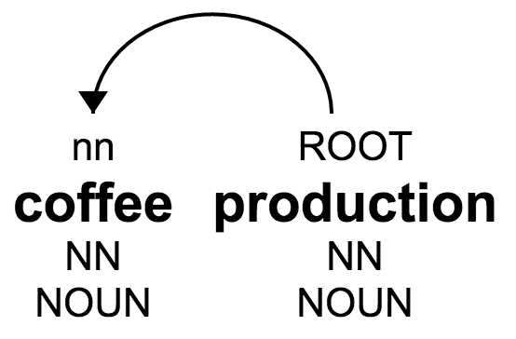
Generating candidate rules
Use dependency parsing (a well-known NLP technique) to identify head word, modifier
coffee production
<modifier>
<head>
Modifier:
Dependent noun
Head:
root of tree
Notes:
Dependency parsing is a given rule

Slide 37
Generating candidate rules
Use dependency parsing to identify head word, modifier
Generalize modifier along concept nodes of IsA hierarchy
$Crop production
IsA concept hierarchy
$Thing production
crop
thing
$Drink production
drink
coffee production
<modifier>
<head>
coffee
Notes:
Change attributes.

Slide 38
Rule selection
Many candidate rules
Most bad
Noisy IsA hierarchy
Noisily extracted attributes
$Crop production
$Thing production
$Drink production
coffee production
Ideal rule set: cover all correct attributes and nothing else
Inadequate supervision: extracted attributes are incomplete and noisy, no negative attributes.

Slide 39
Negative != All Attributes - Biperpedia
$Crop production
<In Biperpedia>
<Outside Biperpedia>
corn production
mangosteen production
wheat production
chilis production
cotton production
peppers production
potato production
orange production
oilseed production
cacao production
...
...

Slide 40
Generate Negative Attribute Examples
Clue 1: Head and modifier do not frequent on the Web
Candidate rule:
$Device city from “port city” and “gateway city”
IsA hierarchy implies new attributes:
battery city, printer city, wheelchair city
Most of these not frequent on the Web
IsA concept hierarchy
Countries
Device
location
battery
port
gateway
printer
wheelchair

Slide 41
Generate Negative Attribute Examples
Clue 2: Word embedding distance with positive attributes
$Project cost
Cars
production cost
maintenance cost
repair cost
shipping cost
dam cost
highway cost
Car attributes from Biperpedia
Frequent on the web, but not car attributes. How to detect that?
Notes:
Mention that these are Car attributes.

Slide 42
Generate Negative Attribute Examples
Clue 2: Word embedding distance with positive attributes
$Project cost
Cars
production cost
maintenance cost
repair cost
shipping cost
dam cost
highway cost
Car attributes from Biperpedia
Frequent on the web, but not car attributes. How to detect that?
Far away in embedding space
highway cost
production cost
repair cost
maintenance cost
dam cost
shipping cost
Notes:
Mention that these are Car attributes.

Slide 43
Final Rule Selection Algorithm [WWW 2016]
A single combined linear program that assigns non-negative weights to rules while:
Maximizing coverage of Biperpedia attributes
port city, production cost, maintenance cost, repair cost, shipping cost
Minimizing coverage of sampled negative attributes
pacemaker city, printer city, dam cost, highway cost
Penalizing overly general rules
Rule penalty score based on rank of Biperpedia attributes in the IsA hierarchy
$Information value, $Location city (but not $Crop production)
Solvable via off-the-shelf LP libraries
Notes:
Need more details here about the method.

Slide 44
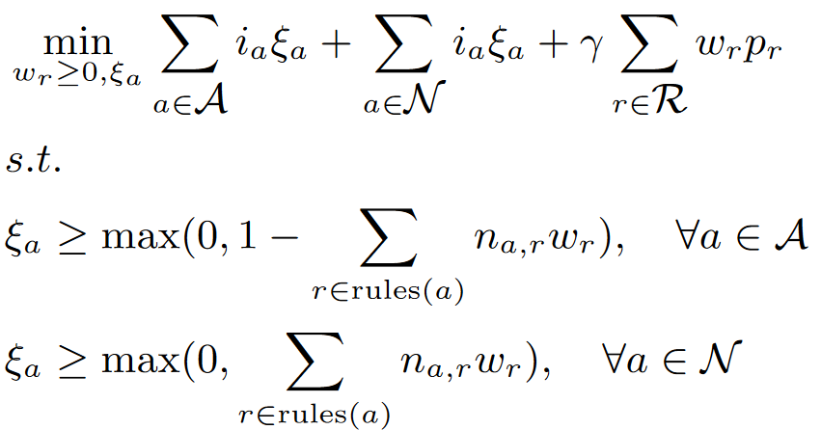
Final rule selection algorithm
Learned weight of a rule
Positive attributes
Confidence in the attribute
Inferred negative attributes
Membership score
Rank in conncept

Slide 45
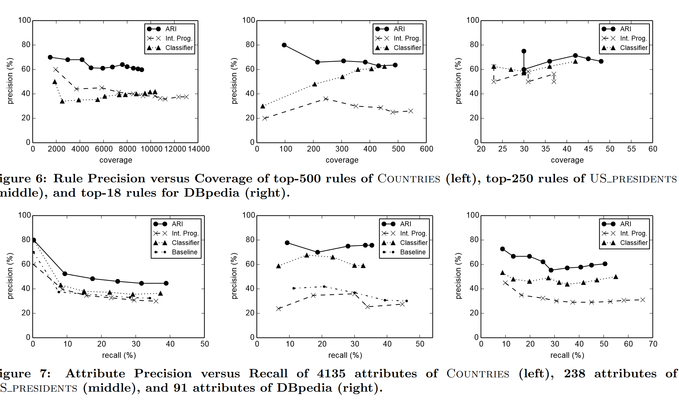
Performance

Slide 46
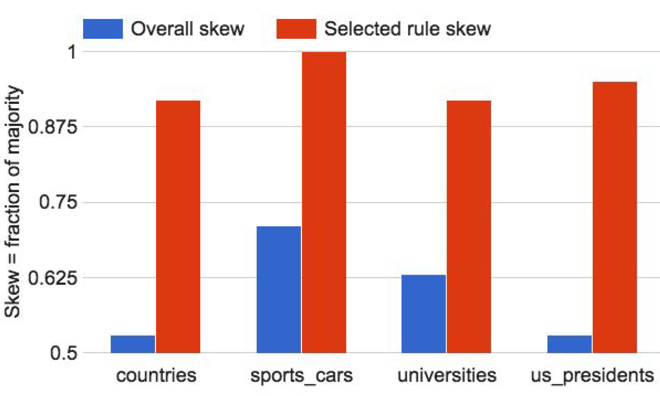
Overall vs. Rule-wise Skew
Notes:
Do not try to explain skew. Get over this quickly.

Slide 47
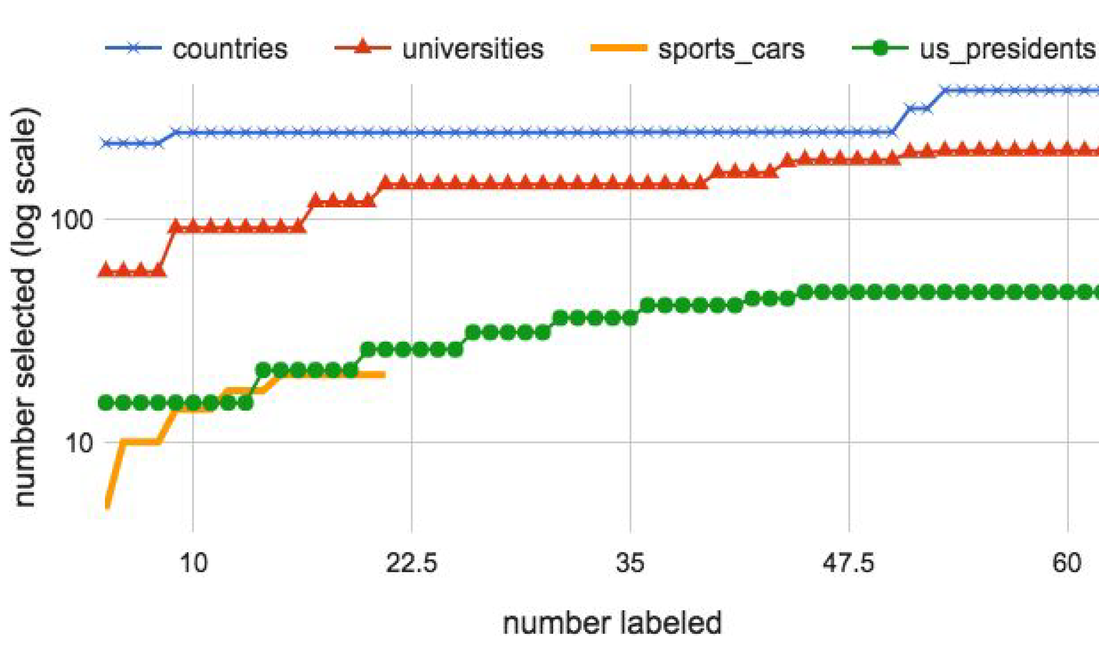
Attribute Curation using Rules
Notes:
Precision of selected set is more than 90% in all cases.

Slide 48
Grammar-driven attribute curation
Join and Aggregate with
Start with
End with
Noisy IsA hierarchy
Curate a small
sample
Attributes
53% precision
Attributes
90+% precision
Occurrence in web text
Word embeddings
Notes:
Missing recall.

Slide 49
In this talk
Extract attributes [Biperpedia]
From Web-text and Query-logs
Organize extracted attributes
Remove noise to meet precision needs of KBs
Generalize to induce even more attributes
Execute entity-attribute queries
Long-tail: value not in KB
Attribute type is number
Seek answer in tables on the Web
Notes:
Start this talk by reviewing a system Biperpedia developed by Google colleagues for automatically extracting long-tail attributes from query-logs.
But before these can be used to populate a KB, need to remove inevitable noise by efficient curation. Our approach is to develop a grammar: that is human-interpretable and has other incidental advantages like induction of more attributes not in logs and handle compositonal queries.

Slide 50
Components of an entity-attribute answer engine
Knowledge Base
User Query Q
Population
Navigational
Schema
Number
Query type?
List seeking
Country
Capital
Cities
Entity-attribute
query
Entity
Revenue
Number
Company
CEO
Parse Q: Find (E, A)
People
Population
49 M
Yes: Head query
Tanzania
Answer in KB?
Done
IsA
Data
Capital
Dodoma
No: Tail query
Country
Extract from Web
Text / Tables / Lists
Company
Revenue
1.1 B
IsA
Apple
CEO
Tim cook
Notes:
Commercial search engines spend huge efforts in distilling the exact answer given the bewildering variety of user queries over the chaotic ocean of information that is the Web.
In recent years, one big savior has been this huge yet manually curated repository of structured information called the knowledge base. The KB stores factual information
About the world. A typical KB contains billions of entities like
Entities == blue.
Classes == Green
Attribute names == yellow
Attributes can be numeric or come from a fixed domain.
Top-part we have the schema that indicates what entity class can have what attribute and what is their domain.
Bottom part is the data itself that can be thought of as triples.
Answer in KB: mostly works for head queries, manually created, cannot target the long-tail universe.
For tail queries: extract from Web text and Web-tables
Well-interpreted query can be better matched to table titles/column headers.

Slide 51
Quantity Queries
Attribute name
Entity
CO₂ Emissions of China
Attribute name
Entity
Height of Mount Everest
Attribute name
Entity
Battery life of Ipad

Slide 52
Papers on quantity attribute extraction
Quantity extraction from text
V. Moriceau. Numerical data integration for cooperative question-answering. In EACL Workshop 2006
M. Wu and A. Marian. Corroborating answers from multiple web sources. In WebDB: 2007
[qcq] S. Banerjee, S. Chakrabarti, and G. Ramakrishnan. Learning to rank for quantity consensus queries. In SIGIR 2009
[scad] A. Bakalov, A. Fuxman, P. P. Talukdar, and S. Chakrabarti. SCAD: collective discovery of attribute values. In WWW 2011

Slide 53
Papers on quantity attribute extraction
Quantity answers from tables
M. Zhang and K. Chakrabarti. Infogather+: semantic matching and annotation of numeric and time-varying attributes in web tables. SIGMOD 2013.
S. Sarawagi and S. Chakrabarti. Open-domain quantity queries on web tables: annotation, response, and consensus models, KDD 2014

Slide 54
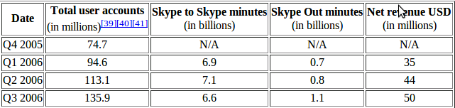
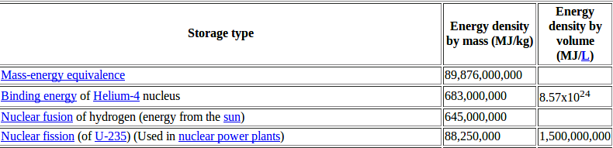
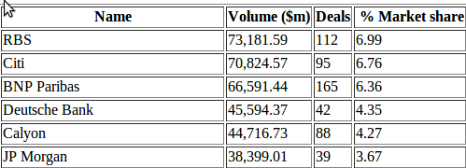
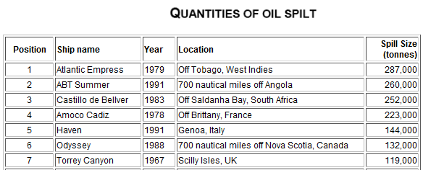
Tables and Numbers
40% of Web tables columns are numeric
Long tail of numeric values missing from Knowledge Bases (KBs) but present in Web Tables
Total user accounts of Skype in 2012 Q1
Energy density of magnetic fields
Syndicated loan volumes
Quantity of major oil spills
Notes:
For example, such tables are not seen in typical knowledge bases

Slide 55
escape velocity jupiter
Notes:
Consider the query:

Slide 56
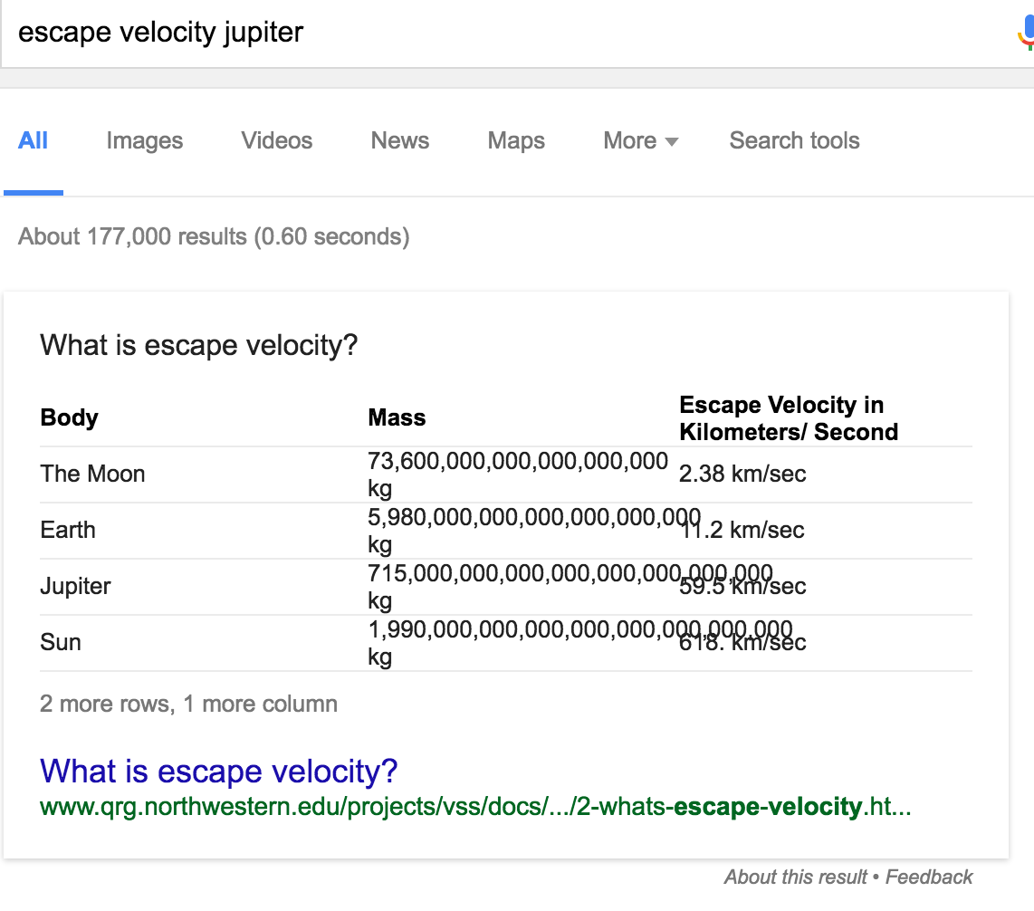
Results from search engine

Slide 57
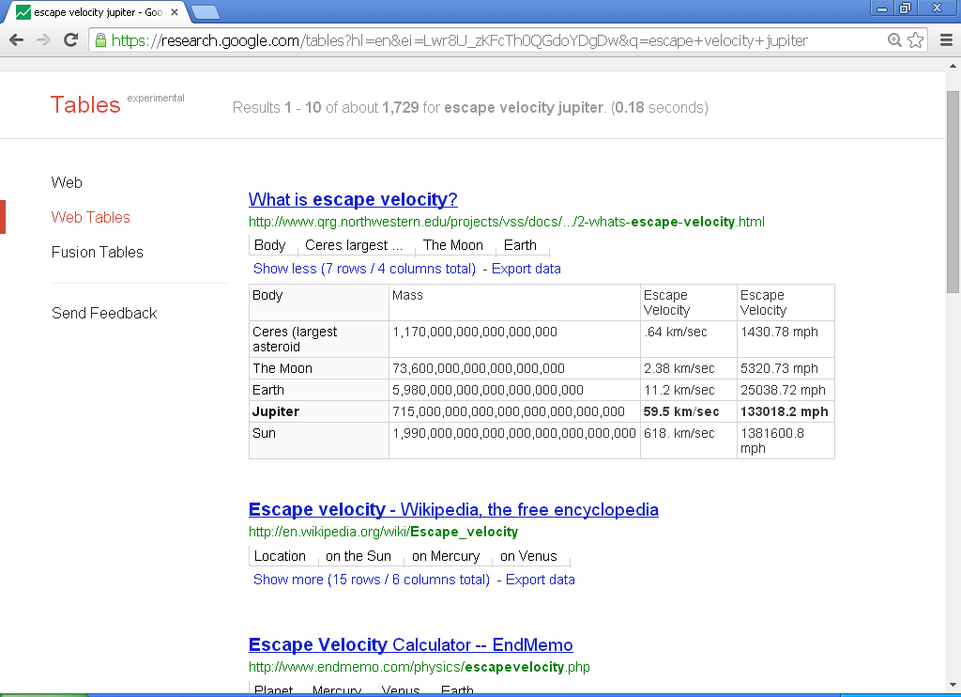
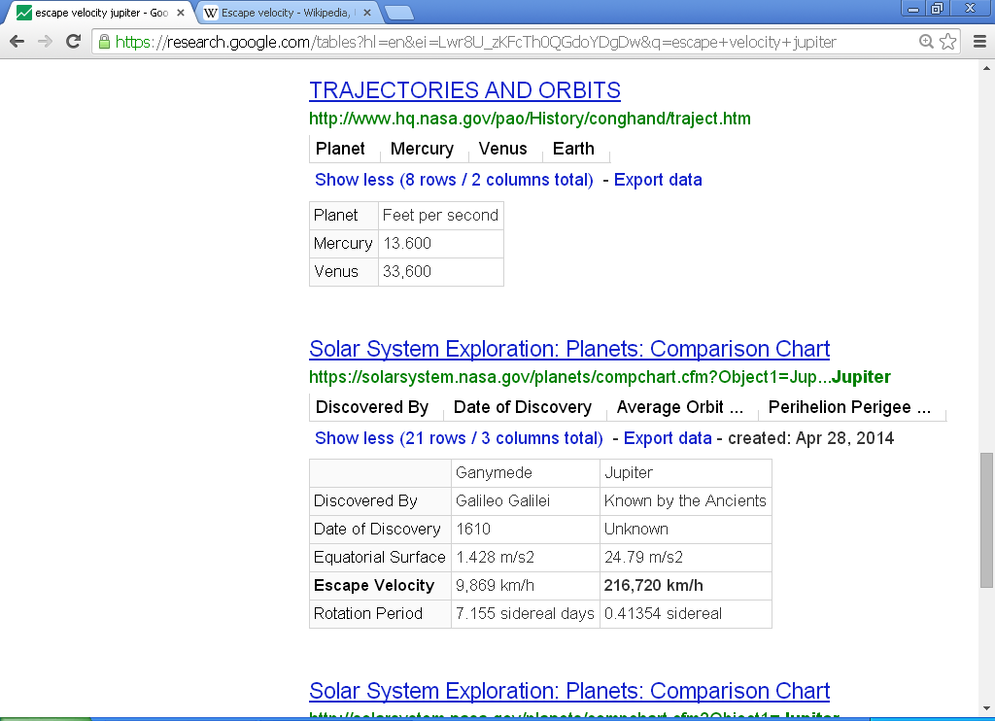
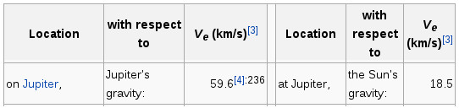
Web tables
Notes:
Meanwhile there are 100s of millions of tables on the web, many of which contain the answer to quantitative queries such as these because 40% of table columns are numeric.
However, extracting the exact answer from these organically created tables on the Web requires many careful steps

Slide 58
Extracting attribute value from Webtables
Match query text with table context, caption, column/row header, cell, …?
Extract number and unit (and possibly a unit multiplier)
number (59,2 = 59.2 or 592?)
unit (m = meter or million? kt is kiloton or knot or karat?)
Punctuations and separators: “Wind speed (km/h / mph)”
Be robust: retain many possible extractions
Collectively attain quantity consensus
Different from consensus for discrete answers --- no key
No query-independent notion of “slight variation”
Notes:
What is required to tap them to present an answer to a user?
First, we need to match the query keywords in a way that is congnizant of the structure of the table spanning its row, column cells, header, title, and surrounding text.
Second, we need to grapple with the ambiguity of parsing numbers and units from tables. Anyone who has stared at such content long enough, will get baffled with the bewildering variety of mentions of number/units.
59,2 is 59.2 in an electronic catalog but 592 typically.
m could be meter or million or mach number?
Kt could be kiloton or knot or karat.
Even a simple / can take two different meanings in a unit on a table header.
We therefore try to be robust by keeping around multiple extractions and depending on consensus from other extractions to create the answer.
Consensus itself is tricky for continuous quantities ---- unlike for discrete answers cannot count support via an exact key. Numbers often have slight variation, and it is not easy to characterize “slight” in a query-independent way.

Slide 59
Step 1: Matching query to table
escape velocity
jupiter
0.6
1.0
Assign relevance
probability
1.0
List of escape velocities
0.4
0.4
Notes:
Matching the query keywords to rows/columns/context of a table is a noisy process.
We assign a relevance probability of each snippet based on various features that we use to capture evidence of a mtach. We combined these to assign probability of relevance to each snippet

Slide 60
Step 2: Number and Unit extraction
Notes:
Extract the number in each cell.
Number is meaningless without unit.
Different cells in different units. So we need to convert each extracted value to its canonical form.
For this, we need to annotate the unit with respect to a well-defined unit of measurements that lists their inter-conversion methods.

Slide 61
Step 2: Number and Unit extraction
Quantity
Unit catalog
QuTree
Seeded from Wikipedia
+ lemmas from Web
44 quantity types e.g.
Weight, Length, Speed, Multiplier, Currency, etc.
750 Unit types e.g.
Km/s, km/h, Mach number, kilogram
Multiplier
Currency
Length
Weight
Concepts
metre
pound
US dollar
million
gram
stone
Units
$
m
m
g
st
lb
Symbol
mil
USD
Lemmas
meter

Slide 62
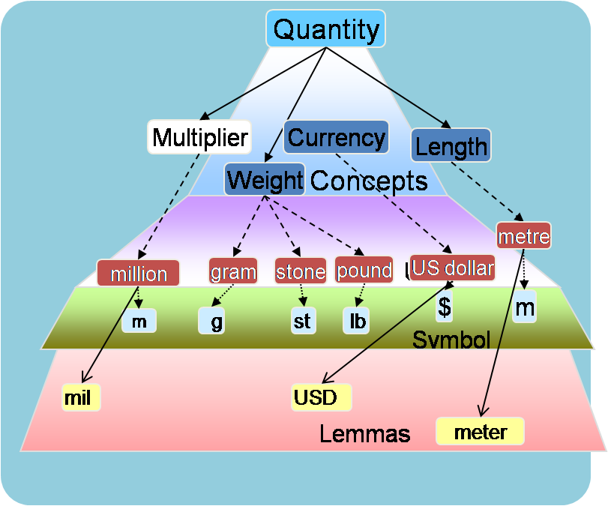
Step 2: Number and Unit extraction
59.5 1
km/s 1
216.720 0.2
216720 0.8
km/hour 0.99
Km/henry 0.01
km/s 0.9
Km/s³ 0.1
59.6 1.0
Notes:
Now our task is to extract number in each cell and annotate it to a unit in the ontology.
Massive problem of noise and ambiguity, we extract multiple numbers and units each with a score.
First case is easy.
Unit annotation is a difficult problem and we will describe how exactly we solve it later.
Convert all numbers to a chosen unit for each quantity.

Slide 63
Step 3: Query attribute type inference
Classify query attribute to one of 44 quantity types
Revenue → money amount
Distance,Length,Height,Width → Length
Our approach: tap unlabeled table corpus.
Many table headers have easy to extract units
“Width in inches”, “co2 emissions in kiloton”, “Average rainfall in inches”, “Fan speed (rpm)”, and “Annual revenue ($ million)”
1.1 million headers from 25 million tables qualify
Labeled data by generalizing extracted unit to its quantity type.

Slide 64
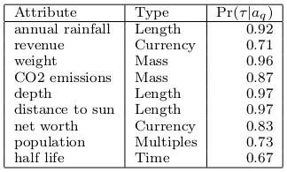
Training attribute type classifier
Width in inches,
CO2 emissions in kiloton,
Average rainfall in inches
Fan speed (rpm)
Annual revenue ($ million)
(Width), Length
(CO2, emissions), Mass
(Average, rainfall), Length
(Fan, speed), Frequency
(Annual, revenue), Money
Train a multi-class logistic classifier

Slide 65
Collective inference
59.6 km/s 0.5 234 km/s 0.5
1.0
Relevance probability
60 km/s 0.7
60 km/s³ 0.3
0.9
Number-Unit score
Pr(Speed|Query)=0.99
60.2 km/s 1.0
0.95
2.56 km/s 1.0
0.6
Candidate extraction
Notes:
During collective inference refine all these probabilities to be more consistent with the global state.

Slide 66
Collective inference
59.6 km/s 0.5 ? 234 km/s 0.5 ?
1.0 ?
60 km/s 0.7 ?
60 km/s³ 0.3 ?
0.9 ?
Pr(Speed|Query)=0.99
60.2 km/s 1.0 ?
0.95 ?
2.56 km/s 1.0 ?
0.6 ?
Notes:
During CI: assume each of these probabilities has a unknown true score which is a hidden variable. We discover its value iteratively. Initial value of the hiidden variables is what we obtained locally.

Slide 67
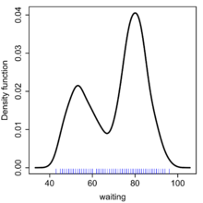
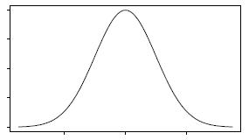
Collective inference
0.999
km/s³
0.001
Km/s
59.6 km/s 0.5 0.99 234 km/s 0.5 0.01
1.0 1.0
59.6 km/s 0.5 0.5 234 km/s 0.5 0.5
1.0 1.0
Re-calculate probabilities
60 km/s 0.7 0.7
60 km/s³ 0.3 0.3
0.9 0.9
Estimate global distribution
Pr(Speed|Query)=0.99
60.2 km/s 1.0 1.0
0.95 0.95
2.56 km/s 1.0 1.0
0.6 0.6
Notes:
During CI: assume each of these probabilities has a unknown true score which is a hidden variable. We discover its value iteratively. Initial value of the hiidden variables is what we obtained locally.

Slide 68
Km/s
1.0
59.6 km/s 0.5 0.99 234 km/s 0.5 0.01
1.0 1.0
Re-calculate probabilities
60 km/s 0.7 1.0 60 km/s³ 0.3 0
0.9 1.0
60 km/s 0.7 0.7
60 km/s² 0.3 0.3
0.9 0.9
Estimate global distribution
Pr(Speed|Query)=0.99
60.2 km/s 1.0 1.0
0.95 0.95
2.56 km/s 1.0 1.0
0.6 0.6

Slide 69
Km/s
1.0
59.6 km/s 0.5 0.99 234 km/s 0.5 0.01
1.0 1.0
60 0.5 km/s
60 0.5 km/s²
0.9
60 km/s 0.7 1.0 60 km/s³ 0.3 0
1.0 1.0
Estimate global distribution
Pr(Speed|Query)=0.99
60.2 km/s 1.0 1.0
0.95 0.95
60.2 km/s 1.0 1.0
0.95 0.99
2.56 km/s 1.0 1.0
0.6 0.6
2.56 km/s 1.0 1.0
0.6 0.01

Slide 70
Unit Annotation
Ratio with new unit
Unit list
QuTree
Inh. /square kilometre
Quantity
Metre|foot
Currency
City | Density (inh. Per km2)
Macau | 19796
Mumbai | 20694
. . . | . . .
Pass | Elevation (m/ft)
Tonale pass | 1884 (6181)
Colle Maniva | 1669 (5476)
. . . | . . .
Multiplier
Weight
Length
million
Concepts
US dollar
gram
stone
pound
Units
meter
m
St
$
m
g
lb
Symbol
mil
gramme
USD
Lemmas
Atomic
unit
Unit with multiplier
Year
British pound [million]
Ratio unit
Year ended | Net profit/(loss) (£m)
2012 | 143
2011 | 40
. . . | . . .
Mega joule/Kilogram
Storage | Energy density by mass in MJ/Kg
Liquid hydrogen | 143
Energy from the sun | 645,000,000
. . . | . . .
Notes:
Todo, complete

Slide 71
Initial annotator: set of rules….did not work
Match after “in” a unit e.g. Price in $, Length in km
Scores in last match → last is also a unit name.
Capacity in kt → kt = carat? Kiloton? Knot?
Match within brackets is a unit e.g Price ($)
Population (Dec 2006), dec is a lemma for unit decade.
s: second, plural e.g. duration(s), year(s)
Concept+unit-match e.g. Length m, Speed mph
Length (m:s)
m gets mapped to meter because of length. Actually, minute.
Energy density by volume (MJ/L)
→ volume helps resolve L as liter.
... Rules not easy for compound units that need simultaneous labelling of different parts
Notes:
Initially, we thought unit annotation was an easy task that can be managed with a set of rules.
Many table headers are of the form:

Slide 72
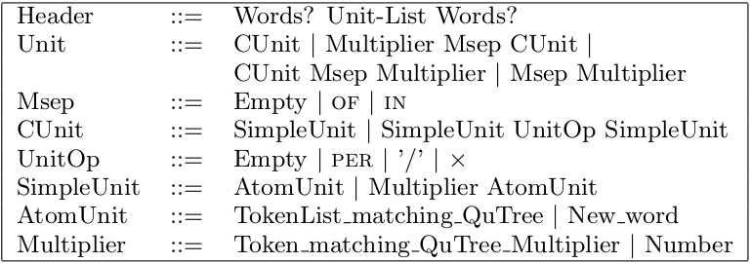
Our approach
Probabilistic Context Free Grammar (QuantCFG)
Grammar: captures possible patterns of derived units
Diverse set of features from several resources
Notes:
Grammar that captures possible patterns of derived units and multipliers as they occur in a table header. With a few iterations, this is easy to get right. Grammar allow many possible parses. Choose one based on features.
Second, is a set of features that are used to encode various lexical clues like brackets, semantic priors, and frequency statistics. Weighted combination of these features provide scores to each ambiguous parse such that the highest scoring parse is more likely to be correct.

Slide 73
Features
Matches in the unit catalog
E.g. Words like Length, Speed matching concept names
Lexical features
After IN, within brackets, etc
Wordnet frequencies
Relative frequency of the unit sense of the term
E.g. “Last” is a unit but 99% frequency is for non-unit sense of last
Co-occurrence statistics from unlabeled table corpus
E.g. Word like “width” appears with “meters”. So, high weight to marking “m” as meters in presence of width

Slide 74
An example parse
Multiple units in a list tend to be of the same type
Wind speed (mph / km/h)
Words
Word
Word
Unit List
Unit
Unit
SU (mile per hour)
SU (kilometre)
PER
SU (hour)
mph
km
/
h
Wind
speed
Sep
/
Header
Brackets
Co-occurrence of “mile per hour” with “speed”
Relative frequency of h in the sense of “hour” in wordnet
Dictionary match
Notes:
Features at different levels: brackets at unit-list.
Dictionary match for simpleunit nodes.
Bias that multiple units are of the same type.
Co-occurrence at unit-level.

Slide 75
Empirical Evaluation
Testbed
QCQ: 28 diverse queries used in [qcq].
WorldBank: 172 queries: forest area, co2 emissions, land area, and population of countries
InfoGather: 146 queries: revenue and profit of 34 large corporations population of 50 large cities,.
Corpus
25 millions Webtables extraction from 500 million webpages
tables returned by research.google.com/tables in response to queries

Slide 76
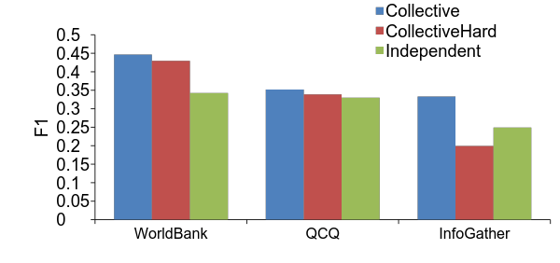
Benefits of collective evaluation
Methods:
Collective: Our method
CollectiveHard: greedily choose local unit+value, hard select query-type
Independent: No collective inference

Slide 77
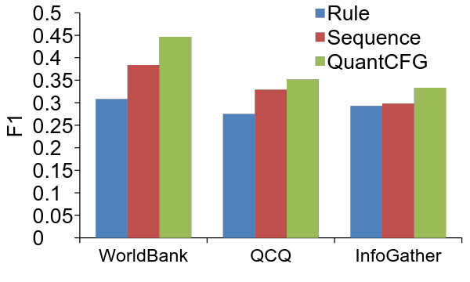
Accuracy of QuantCFG
Rules << QuantCFG
Sequence classifier with same features < QuantCFG

Slide 78
Interval generation
Answer as a continuous density h may not be user-friendly
Intervals I: ranked list of intervals
Methods:
UniformMix: approximate h by a mixture of uniform distribution.
MDL:
Assume a reference set Sq of all values seen in all relevant table columns.
The extracted values V are a subset of Sq
Intervals == most compact way of conveying V to a receiver who already has Sq.

Slide 79
Choice of distribution function h()
Methods:
Continuous densities: Kernel, Wavelet, Variable width kernels
Point: each extraction value is distinct. No consensus from close-by values

Slide 80
Interval generation methods
UniformMix:
Approximate h as mixture of uniform
MDL
Min-cost transfer of relevant values from query-specific reference set

Slide 81
Summary
Web tables: rich source of “long-tail” structured data, specifically for quantities.
40% of table columns are numeric
Lessons learnt
Exploit structure in Web-tables
Join with quantity taxonomies
Bootstrap unit-extractor from well-formed tables
Exploit redundacy → Collective inference
Unit extractor from Web tables
PCFG + frequency + co-occurrence from unlabeled corpus

Slide 82
Code and data at http://github.com/ssprojects/UnitTagger
Reference
Open-domain quantity queries on web tables: annotation, response, and consensus models, KDD 2014

Slide 83
Concluding Observations
Extracting long tail attributes of classes from query logs
Biperpedia has very high recall but low precision in the long tail
Not directly useful for KB augmentation and query interpretation
Organize attributes via grammar rules
Efficient curation of attributes at scale
Interpretable rules → high-quality generalization to add new attributes
Compositional form → go beyond treating attributes as strings → recognize variants
Executing long-tail number queries on Web tables
Web tables: rich source of “long-tail” structured data, 40% of table columns are numeric
Many details in extracting exact answer and gathering consensus from multiple sources
Notes:
Separate slide for future values: vague, concrete values.

Slide 84
What next?
More query types
Derived numerical queries composed from multiple sources
Tiger population per square kilometer
Distributional queries over collections
Tiger population in countries
Soft-attribute queries: “cute animals”

